Slide 1


3 December, 2022
Sponsored and Supported by:

Slide 2







A Big Thank You to all the Sponsors!
Diamond:
Learning Partner:
Platinum:
Gold:

Slide 3





SPEAKERS PANEL
Session No 4
Customise SharePoint List forms with SPFx Form Customizer Extension
https://siddharthvaghasia.com
@siddh_me
https://www.linkedin.com/in/siddharthvaghasia
Siddharth Vaghasia
siddharth-vaghasia
Technical Consultant

Slide 4
Why we need to customize Form
Custom layout/UI
Show hide columns based on permission
Custom validation based on fields
Bring data from external API
Saving data to multiple list
Cascading dropdowns

Slide 5
Ways to customize form
Use Form Formatting
Use Power Apps
Use SPFx webpart
Use SPFx form Customizer *

Slide 6
SPFx Form Customizer
The Form Customizer Extension allows developers to customize new, edit and display forms of the lists and document libraries.
Available from SPFx 1.15
Association via content type
React Vs No Framework
Targeted to list/library
Choose which form to customize

Slide 7
Demo

Slide 8
Deployment
Deploy
Deploy as SPFx solution to App Catalog
Install
Install solution to Target Site collection
Associate
Associate Custom component to content type
Provision list via solution
Associate component to content type via REST or CSOM API

Slide 9
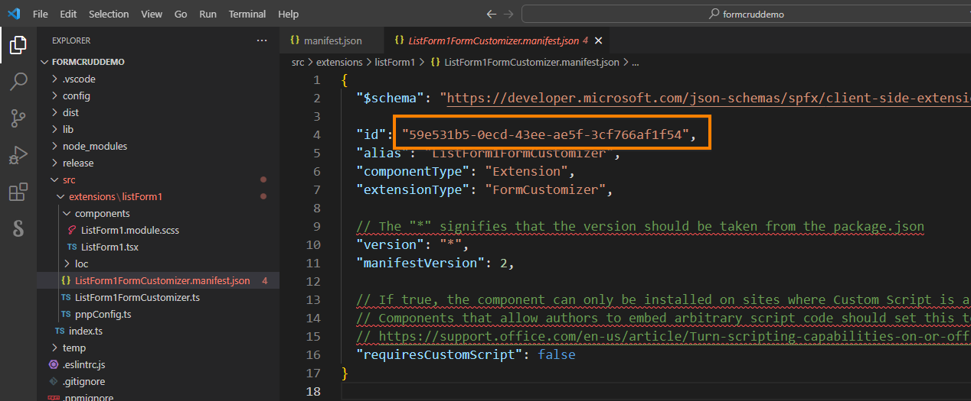
How to get component ID

Slide 10
PnP Powershell
Import-Module PnP.PowerShell
$siteURL="https://mydomain.sharepoint.com/sites/mylab"
Connect-PnPOnline -Url $siteURL -Interactive
$clientContext = Get-PnPContext
$contentType = Get-PnPContentType -List “ListName" -Identity "Item"
$contentType.NewFormClientSideComponentId = "59e531b5-0ecd-43ee-ae5f-3cf766af1f54";
$contentType.EditFormClientSideComponentId = "59e531b5-0ecd-43ee-ae5f-3cf766af1f54";
$contentType.ViewFormClientSideComponentId = "59e531b5-0ecd-43ee-ae5f-3cf766af1f54";
$contentType.Update($false)
$clientContext.ExecuteQuery()

Slide 11
REST API Association Sample Code
/sites/MyLab/_api/Web/Lists(@v0)/ContentTypes(@v1)?&@v0=guid'84f24164-d52e-4f93-967a-cdacb2bc3b36'&@v1='0x0100DA0BEA0C911ADA41B92439DB6E909AB800BB47FFE760BDB5438080508561ADAC9F’
Patch Method
Object to pass
{
'__metadata': {
'type': 'SP.ContentType'
},
'NewFormClientSideComponentId: '',
'DispFormClientSideComponentId': '',
'EditFormClientSideComponentId': '',
'EditFormClientSideComponentProperties': {}
}

Slide 12
CSOM
using (var context = new ClientContext("https://domain.sharepoint.com/sites/sitname"))
{
context.Credentials = GetSharePointOnlineCredentials();
var web = context.Web;
var list = web.Lists.GetByTitle(“DemoList");
var ctypes = list.ContentTypes;
context.Load(web);
context.Load(list);
context.Load(ctypes);
context.ExecuteQuery();
Console.WriteLine("List title: " + list.Title);
var ctype = ctypes.FirstOrDefault(ct => ct.Name == "Item");
if (ctype == null) return;
ctype.NewFormClientSideComponentId = "59e531b5-0ecd-43ee-ae5f-3cf766af1f54 ";
ctype.EditFormClientSideComponentId = "59e531b5-0ecd-43ee-ae5f-3cf766af1f54 ";
ctype.Update(false);
context.ExecuteQuery();
Console.WriteLine("Configuration for " + ctype.Name + " complete.");
}

Slide 13
Reference Links
https://learn.microsoft.com/en-us/sharepoint/dev/spfx/extensions/get-started/building-form-customizer
https://www.c-sharpcorner.com/article/spfx-form-customizer-extension-to-customize-sharepoint-neweditdisplay-form-of/
https://blog.mastykarz.nl/customize-list-forms-sharepoint-framework-form-customizers/

Slide 14

SPEAKERS PANEL
Next Session
Turbo-boost your SPFx upgrades and deployment using CLI for Microsoft 365
2.50 PM
Arjun Menon
Solution Architect

